Slide 1
Cognitive Service Integrate with Power BI
Egg Cheng
v-egche@microsoft.com

Slide 2

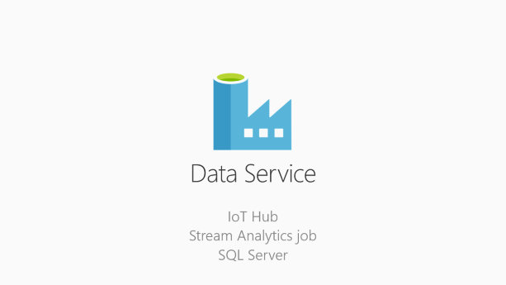
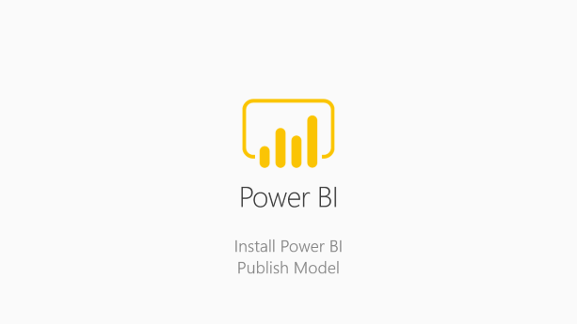
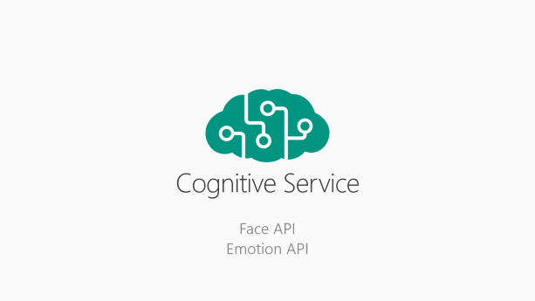
Integration
Cognitive Service
business intelligence

Slide 3

Cognitive Service
Face API
Emotion API

Slide 4
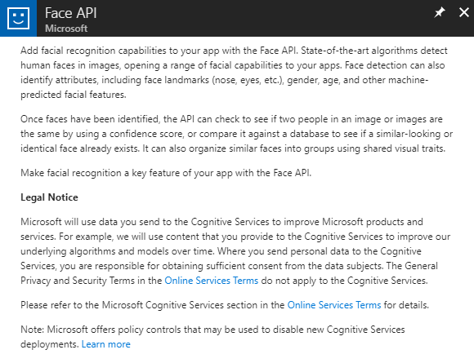
Create Face API
Once faces have been identified, the API can check to see if two people in an image or images are the same by using a confidence score

Slide 5
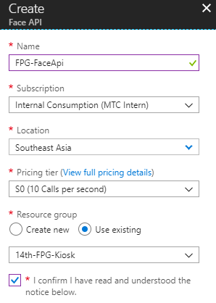
Create Face API
Configure Settings
Configure Settings

Slide 6
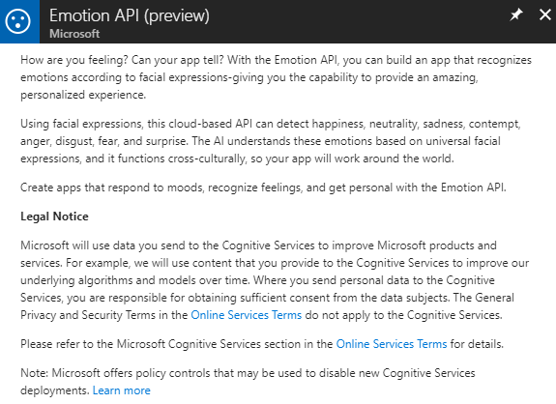
Create Emotion API
Using facial expressions, this cloud-based API can detect happiness, neutrality, sadness, contempt, anger, disgust, fear, and surprise.

Slide 7
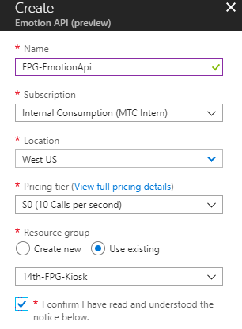
Create Emotion API
Configure Settings

Slide 8

Data Service
IoT Hub
Stream Analytics job
SQL Server

Slide 9
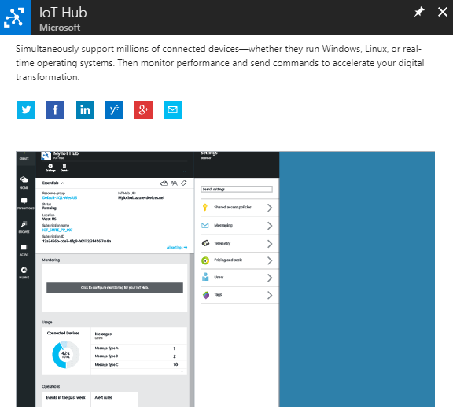
Create IoT Hub
Provides multiple device-to-cloud and cloud-to-device communication options. These options include one-way messaging, file transfer, and request-reply methods.

Slide 10
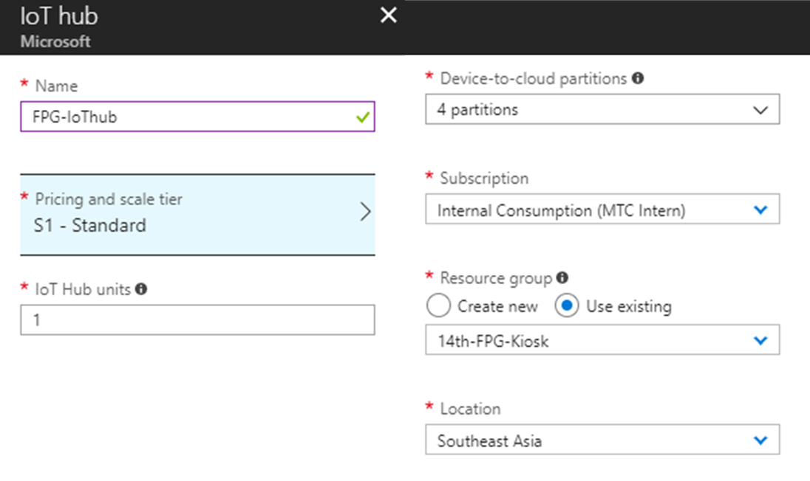
Configure IoT Hub Settings
Configure Settings

Slide 11
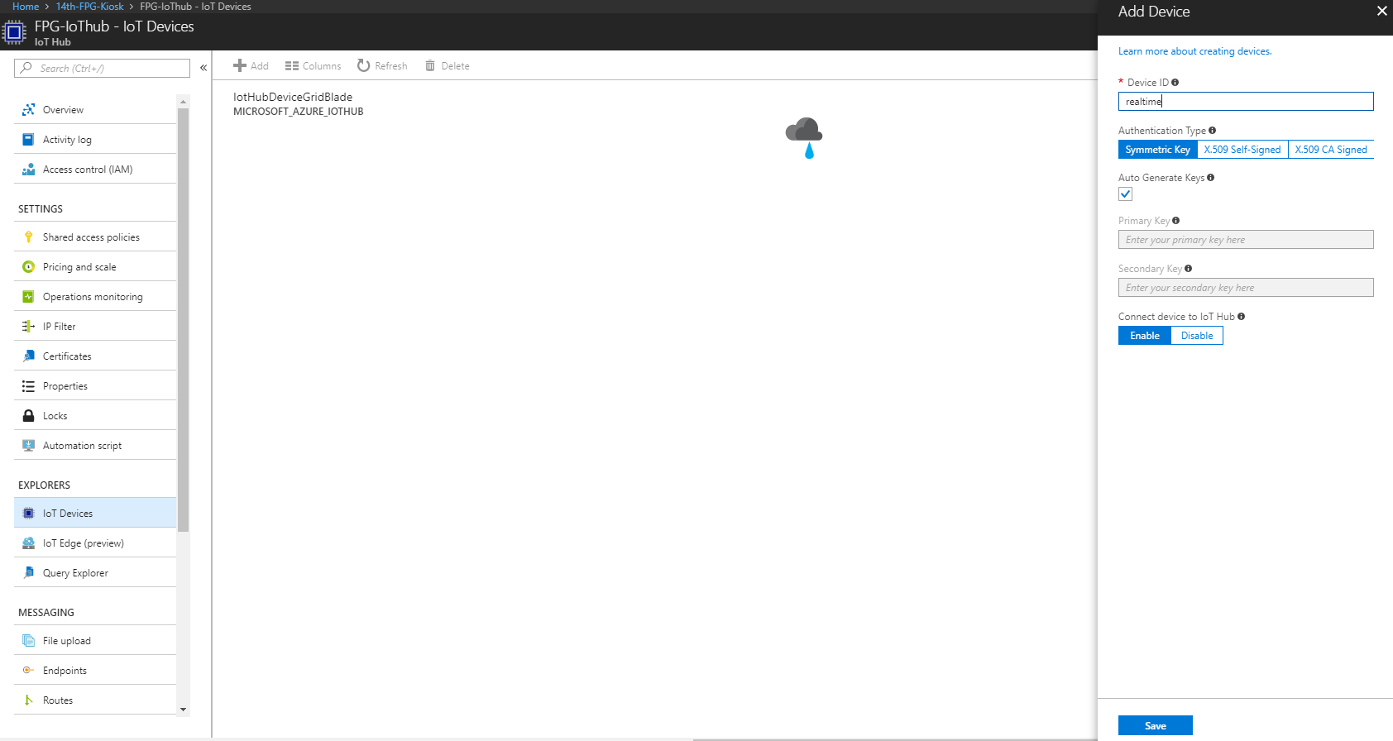
IoT Device
Add a new

Slide 12
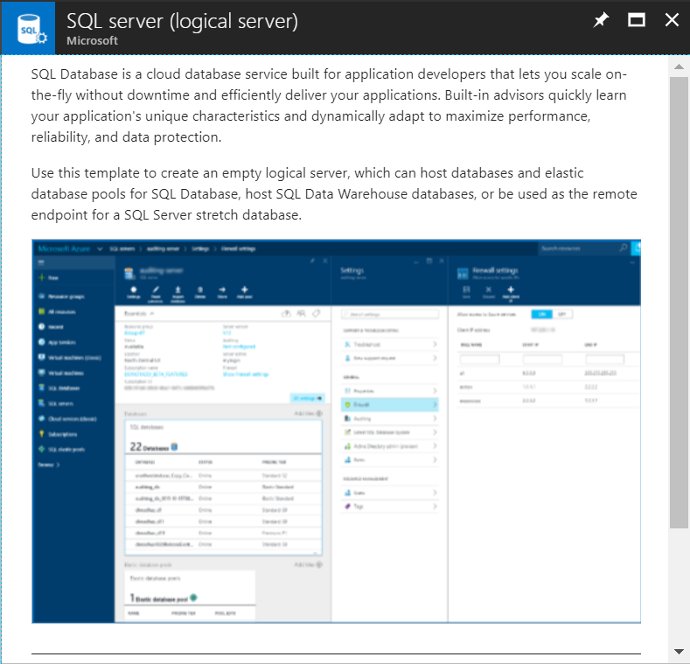
Create SQL Server
SQL Database is a cloud database service built for application developers that lets you scale on-the-fly without downtime and efficiently deliver your applications.

Slide 13
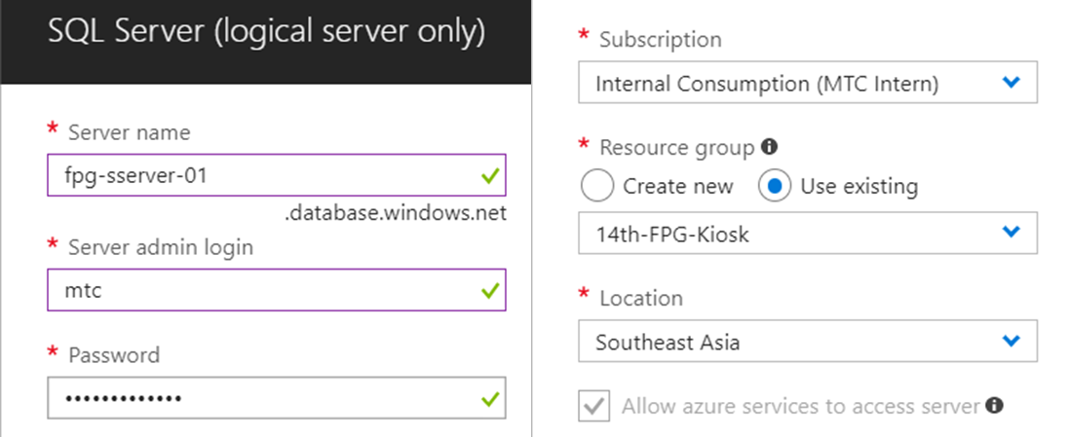
Setting SQL Server Account
Setting admin account & Southeast Asia location

Slide 14
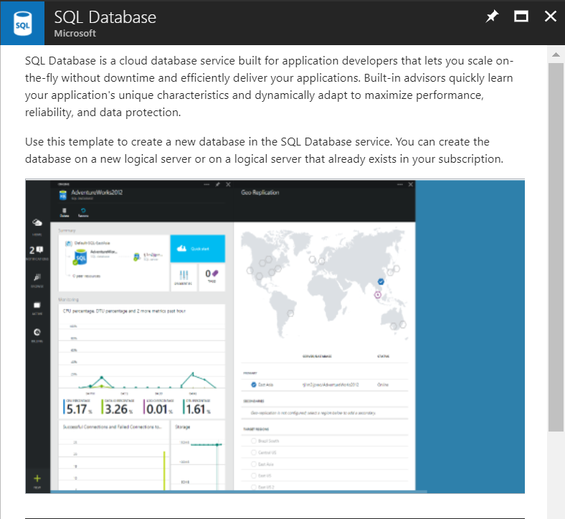
Create SQL Database
SQL Database is a cloud database service built for application developers that lets you scale on-the-fly without downtime and efficiently deliver your applications.

Slide 15
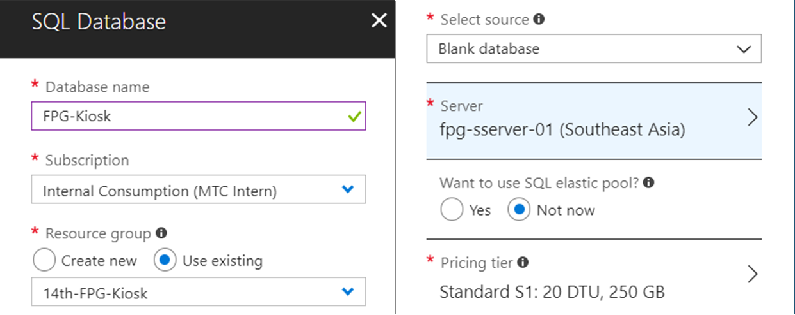
Create SQL Database
Setting server

Slide 16
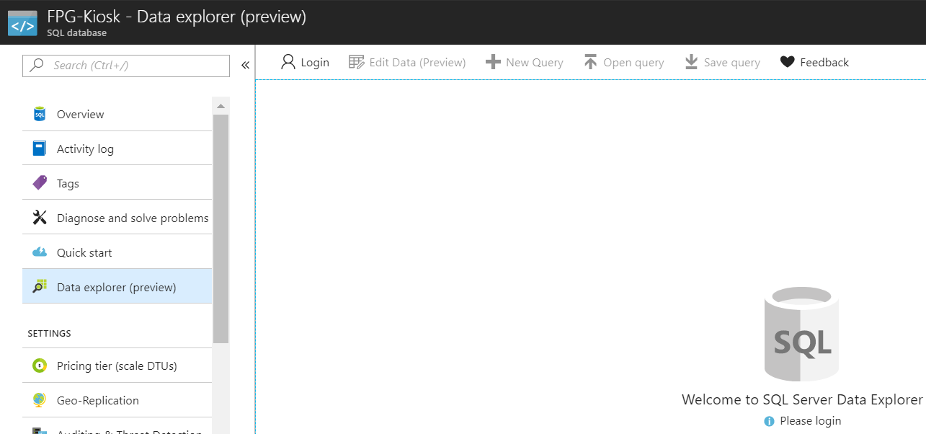
Login into SQL Server

Slide 17
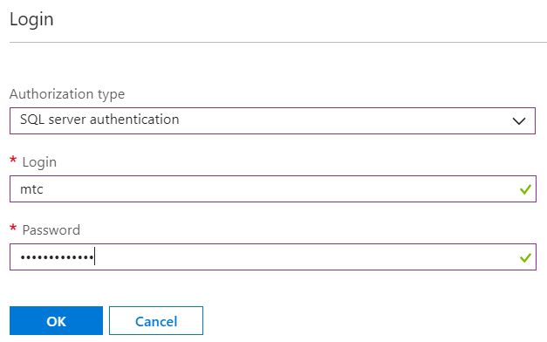
Login into SQL Server

Slide 18
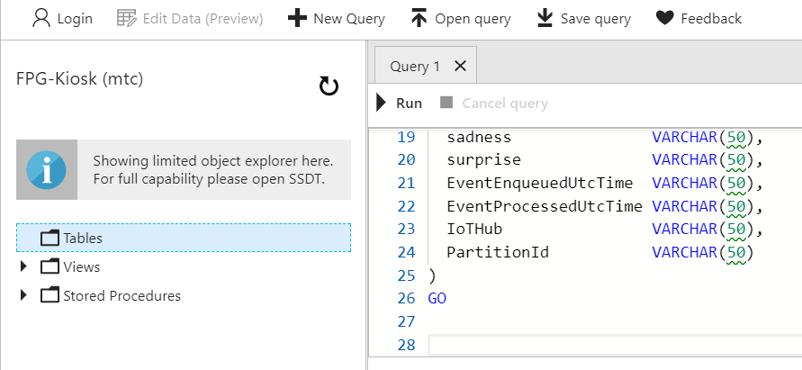
Paste SQL Code
Using the code which in the following link
https://aka.ms/IntelKiosk_SQL

Slide 19
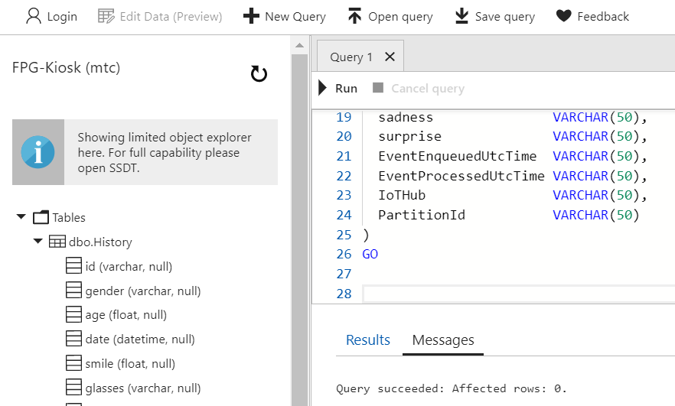
Reload & Check

Slide 20
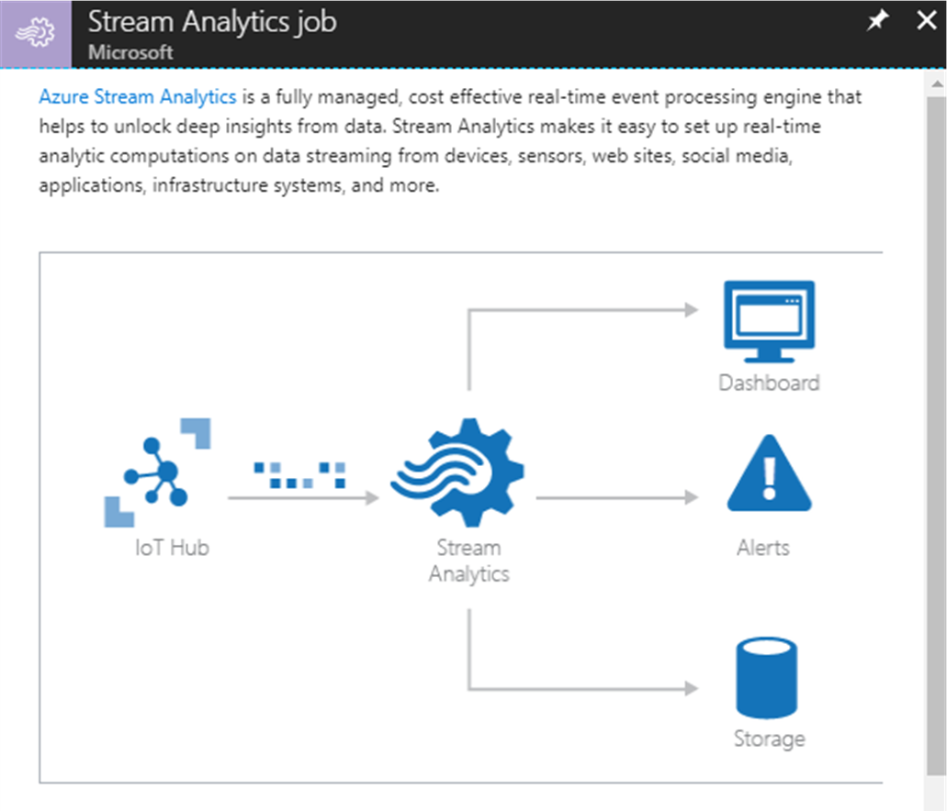
Create Stream Analytics Job
Azure Stream Analytics is a fully managed, cost effective real-time event processing engine that helps to unlock deep insights from data

Slide 21
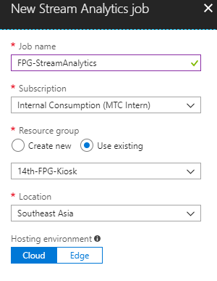
Configure Stream Analytics Job

Slide 22
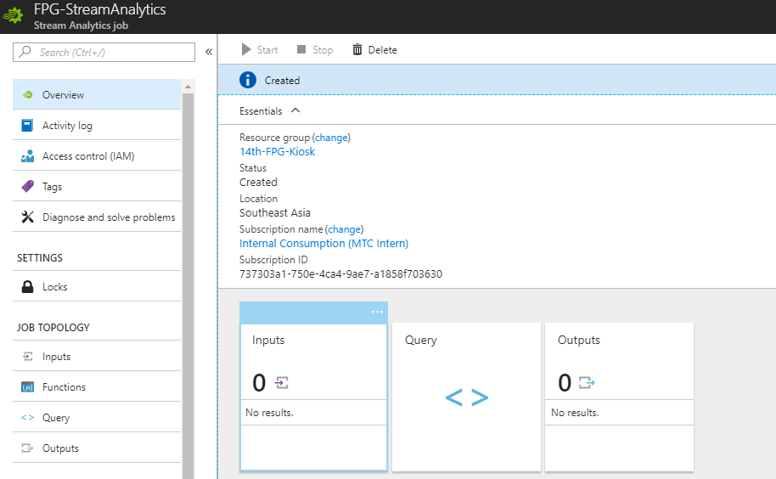
Setting Stream Analytics Job Inputs

Slide 23
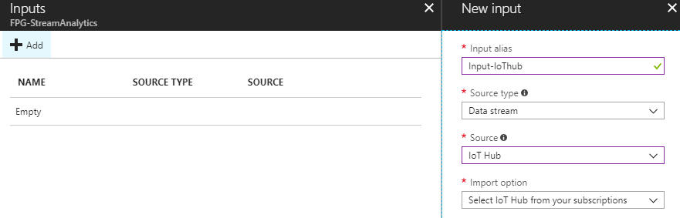
Add a new input from IoT Hub

Slide 24
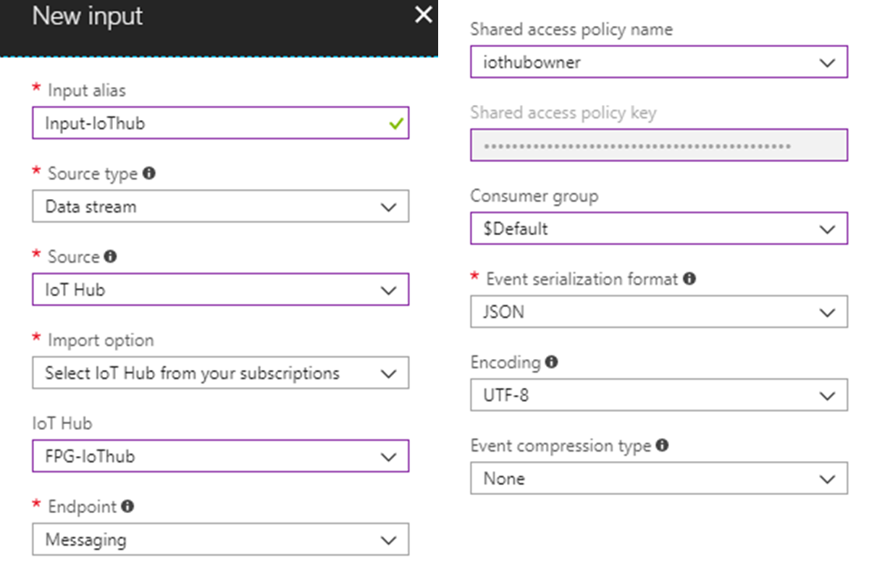
Setting Input Source

Slide 25
Setting Stream Analytics Job Outputs

Slide 26
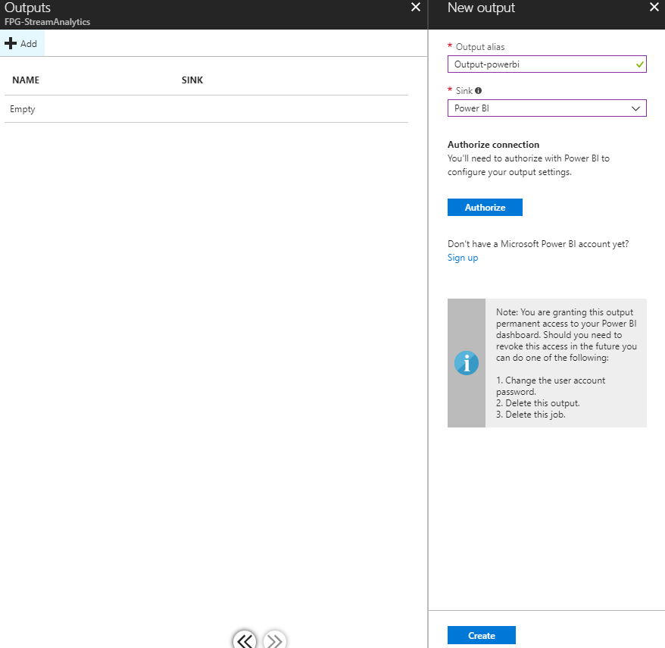
Create Stream Analytics Job
Configure Settings

Slide 27
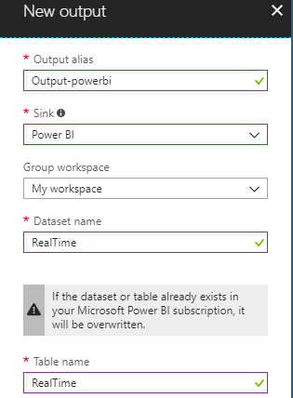
Setting Output to Power BI

Slide 28
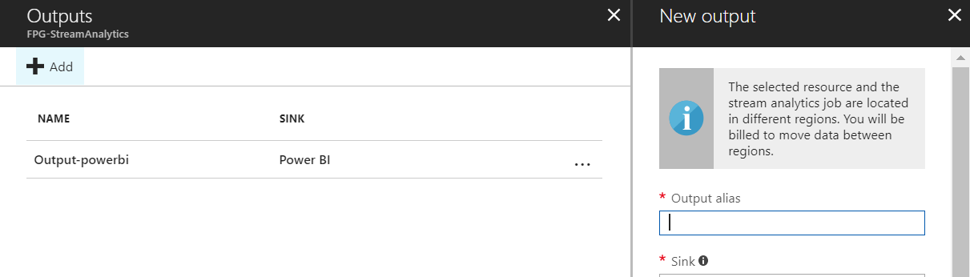
Add a new output to SQL Server

Slide 29
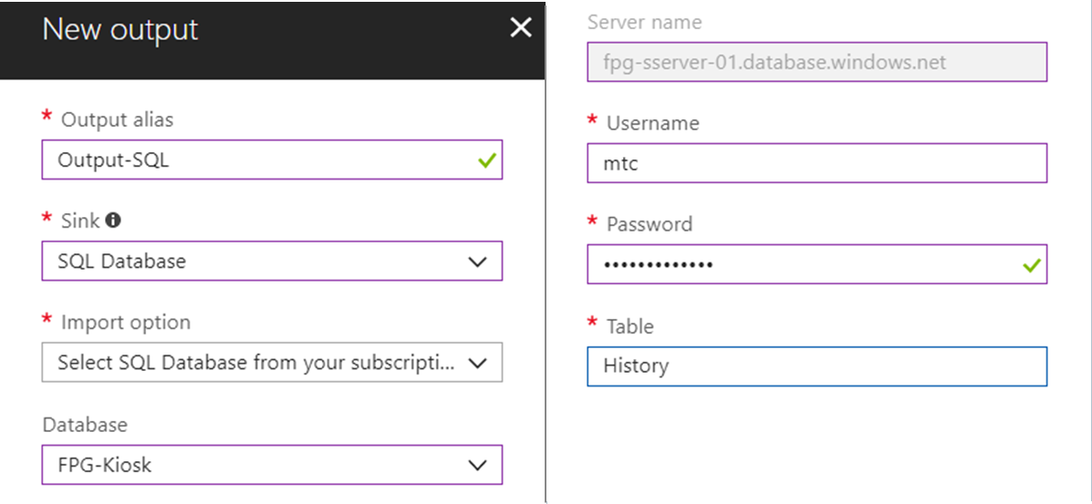
Setting Output to SQL Server

Slide 30
Setting Stream Analytics Job Query

Slide 31
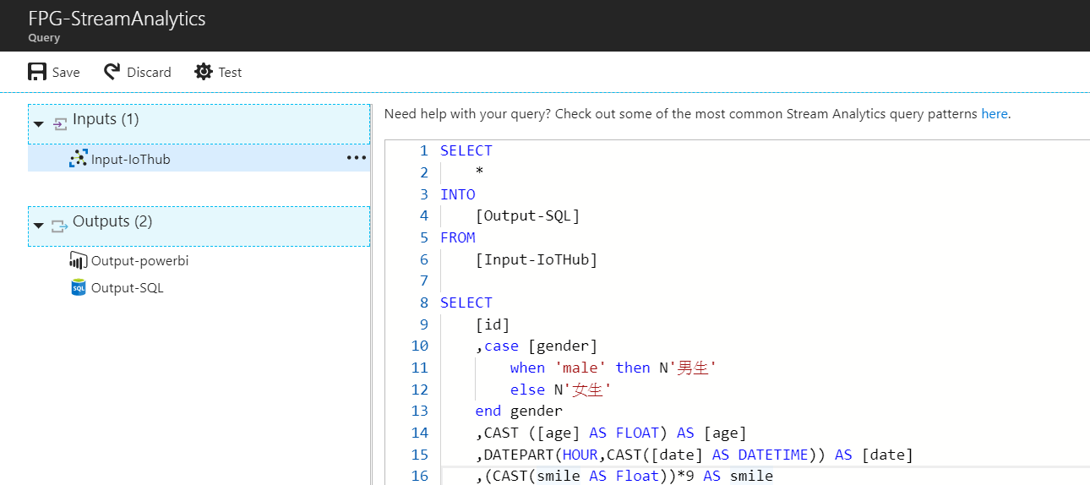
Setting Query
Configure Settings

Slide 32
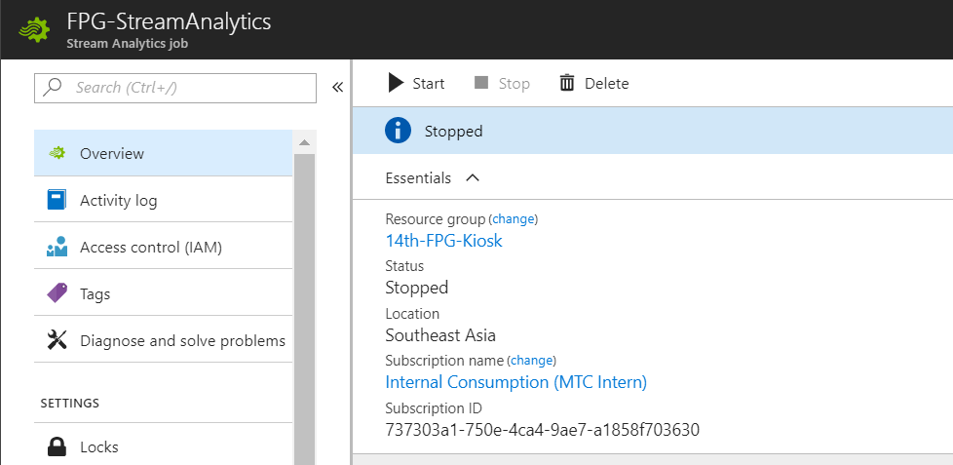
Enable Stream Analytics Job

Slide 33

Download Intelligent Kiosk Sample
https://aka.ms/IntelKioskSample

Slide 34
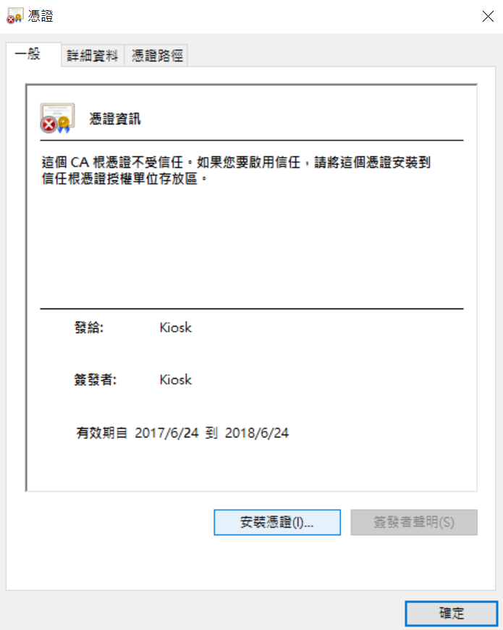
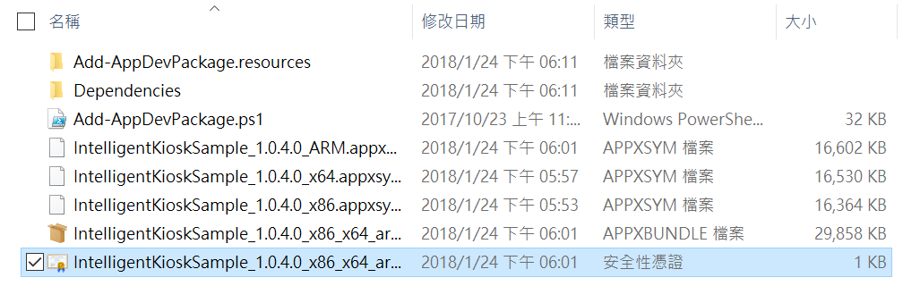
Install Certificate

Slide 35
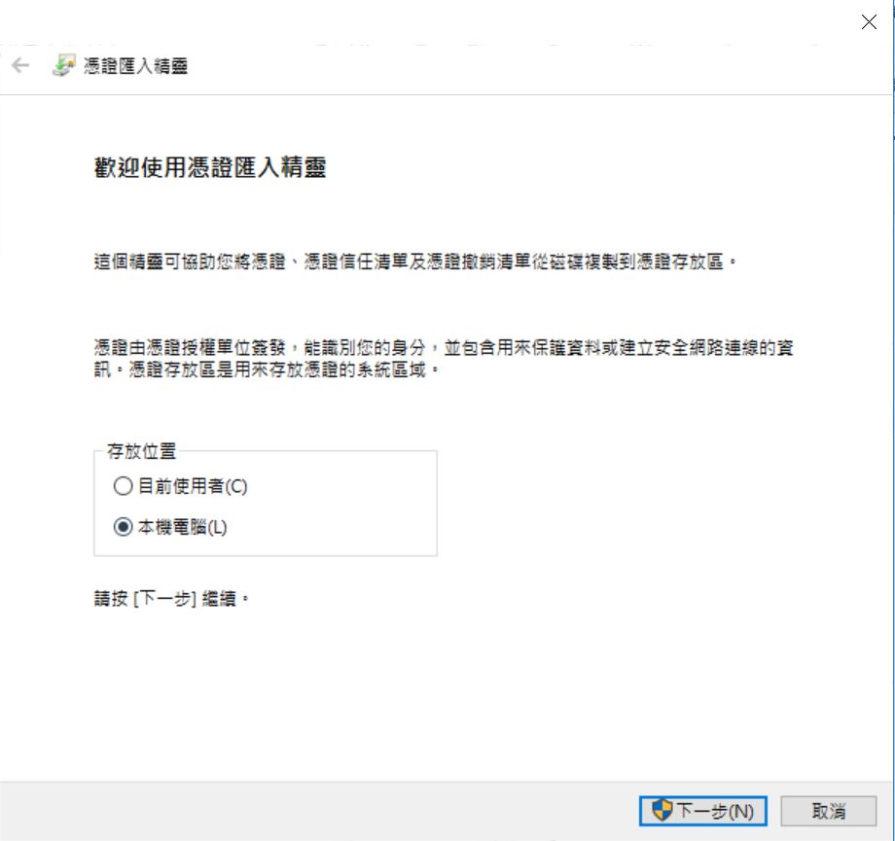
Select Local Machine

Slide 36
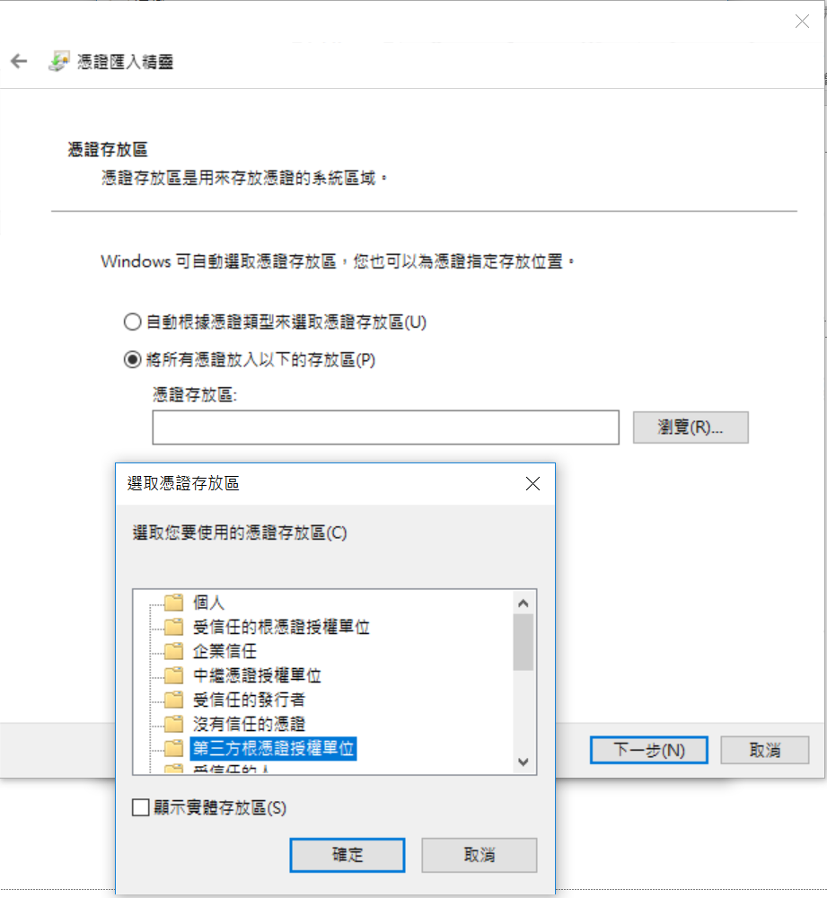
Select Third-Party Root Certification

Slide 37
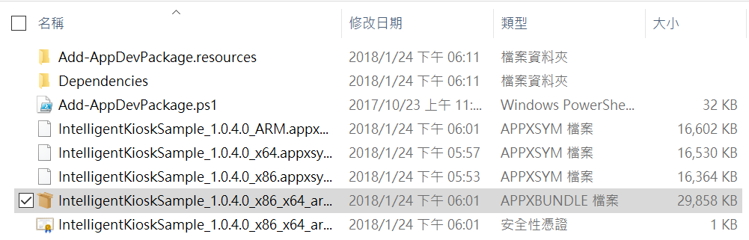
Select Third-Party Root Certification

Slide 38
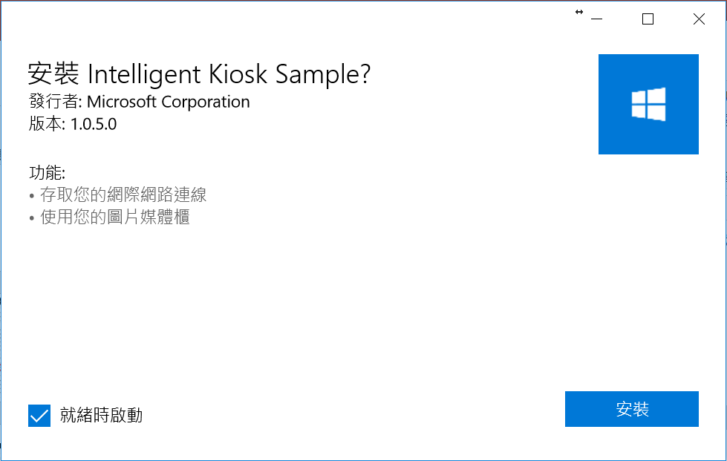
Install Intelligent Kiosk Sample

Slide 39
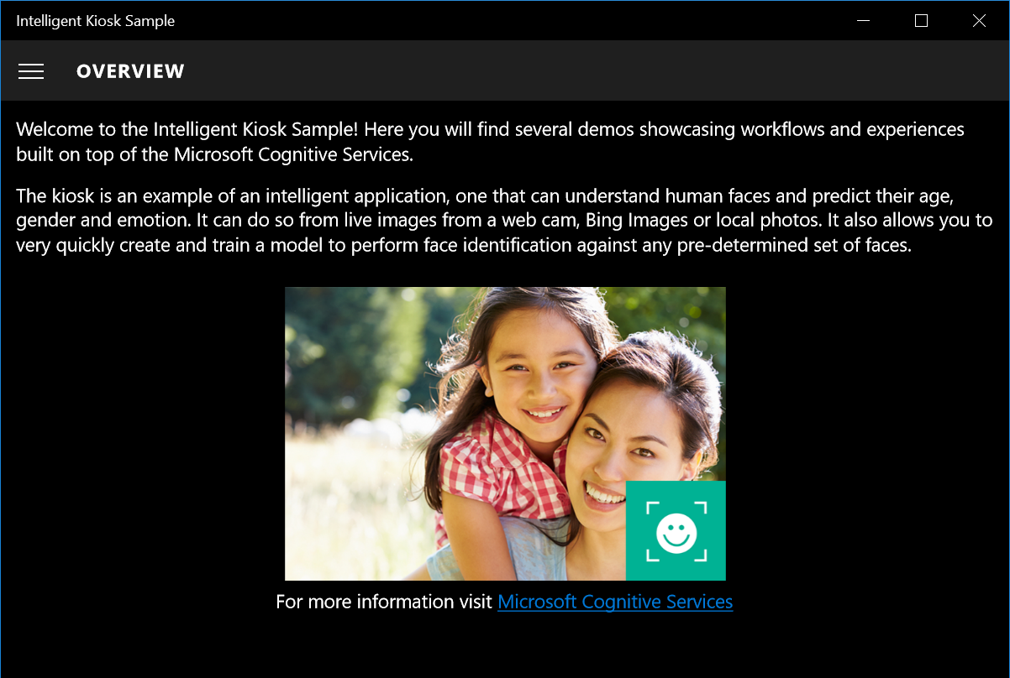
Launch Intelligent Kiosk Sample

Slide 40
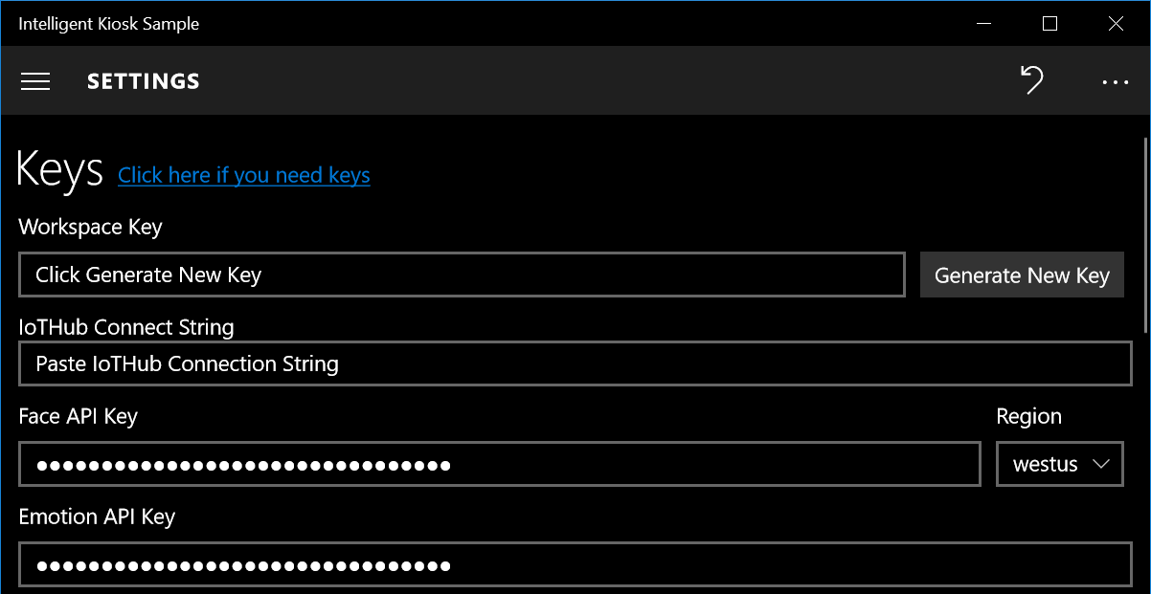
Setting API Keys

Slide 41
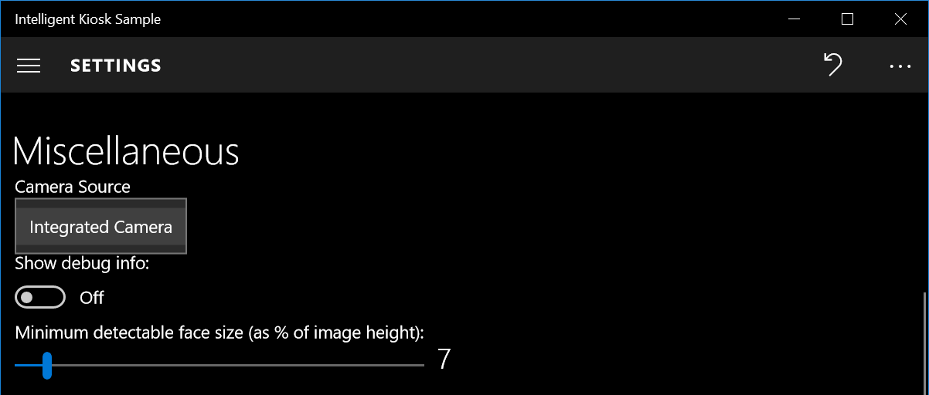
Setting Camera

Slide 42
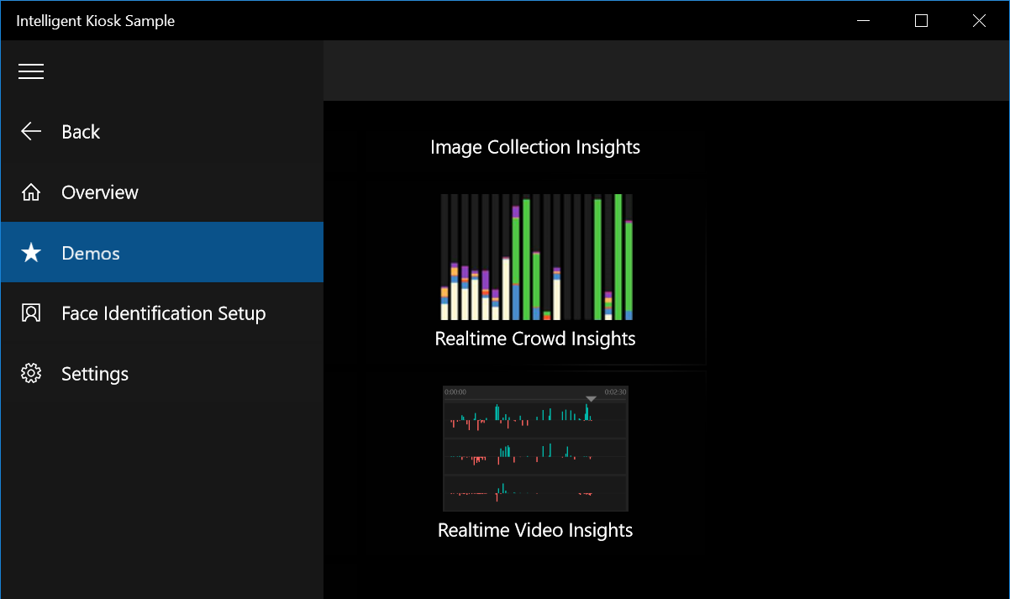
Launch Demo

Slide 43
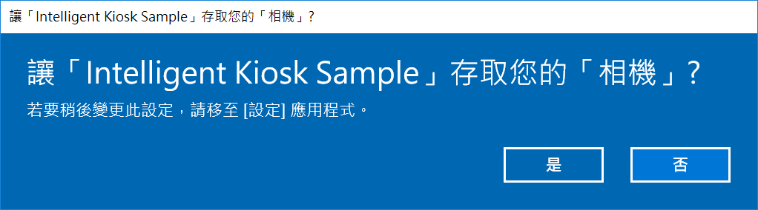
Allow Permission

Slide 44
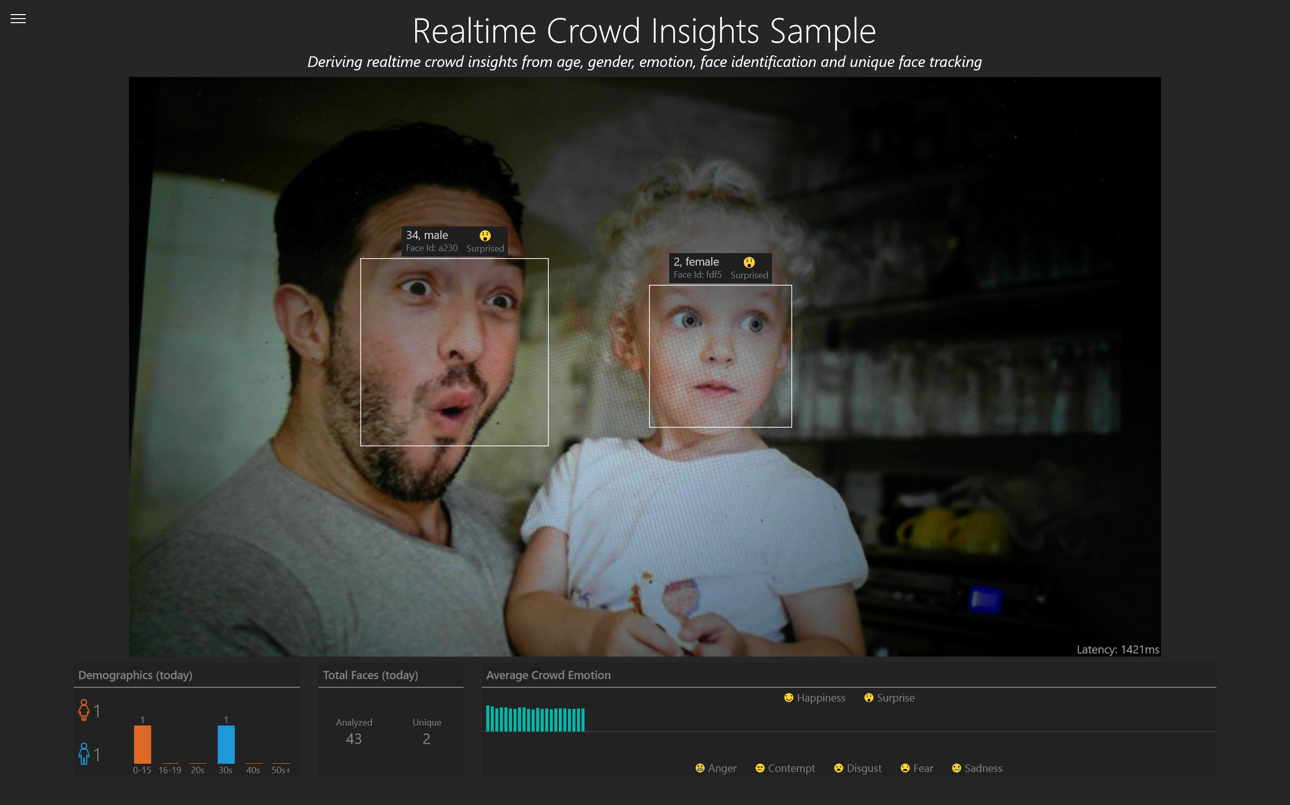
Demo

Slide 45

Power BI
Install Power BI
Publish Model

Slide 46

Download Power BI Desktop Document
https://aka.ms/IntelKiosk_BI

Slide 47
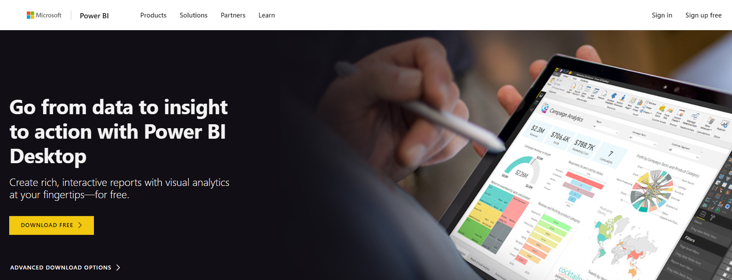
Download Power BI Desktop
https://aka.ms/download_powerbi

Slide 48
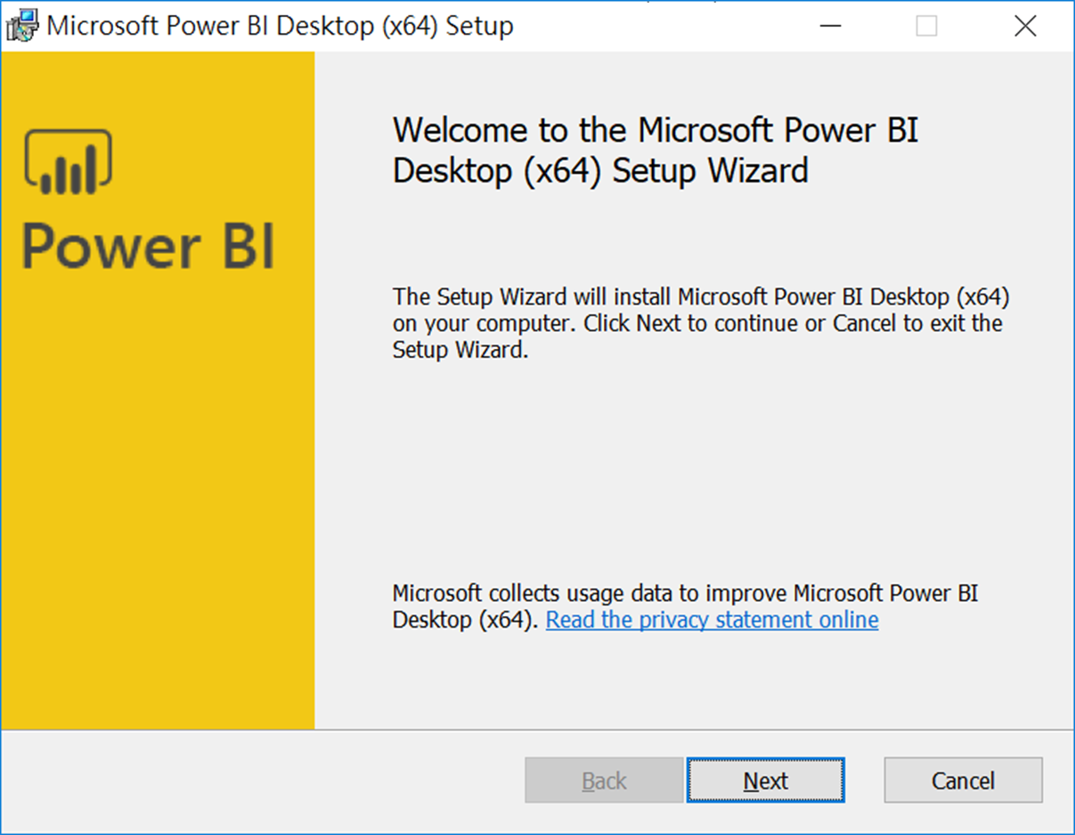
Install Power BI Desktop

Slide 49
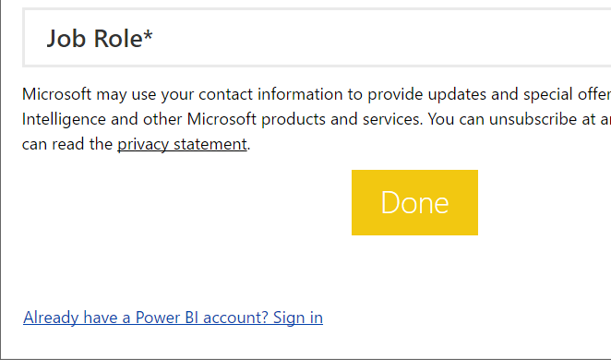
Click Sign In Link

Slide 50
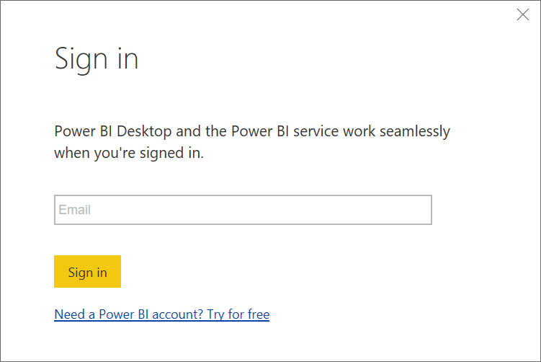
Login into Power BI

Slide 51
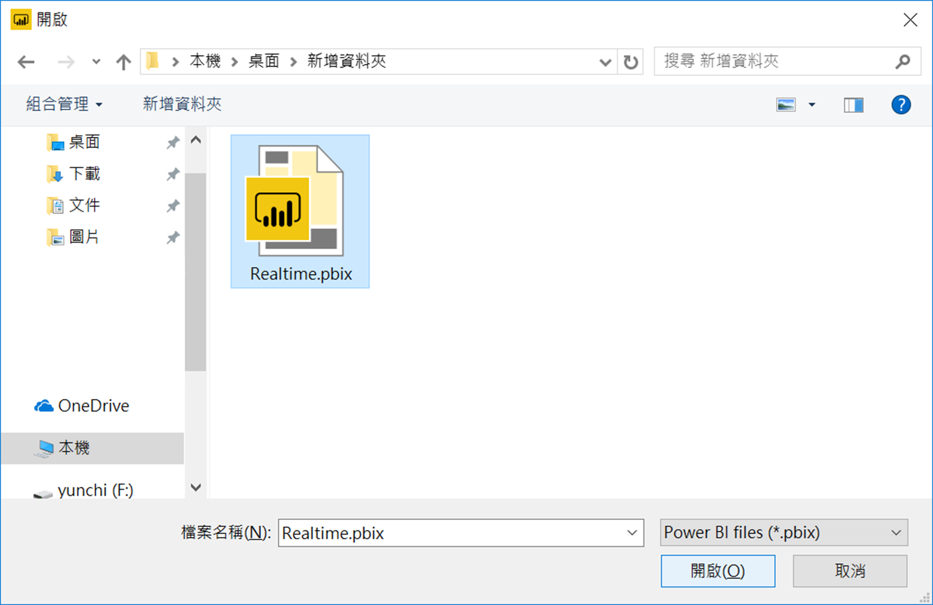
Open Realtime File

Slide 52
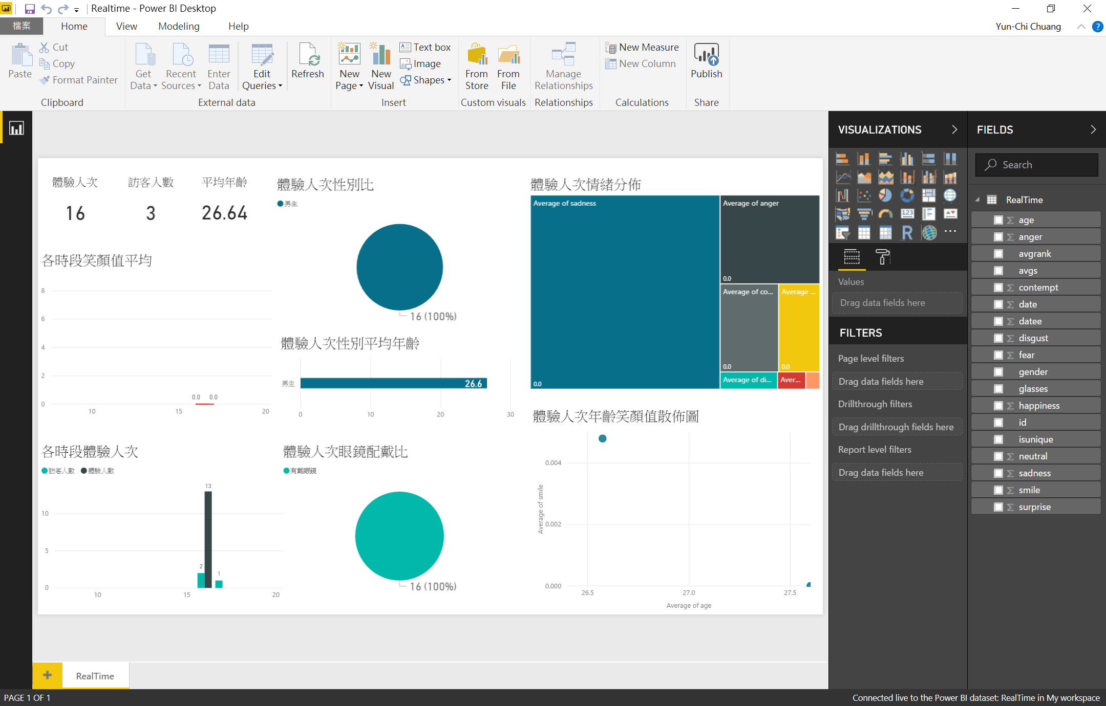
Power BI

Slide 53
Publish Model

Slide 54
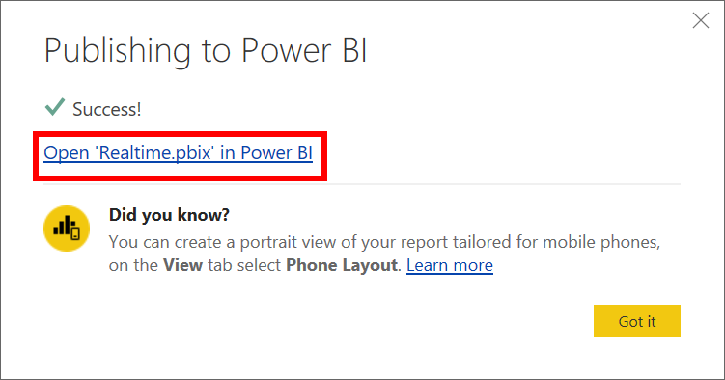
Create Stream Analytics Job
Configure Settings

